Slide 1
ECE408/CS483 Applied Parallel Programming Lecture 7: Performance Considerations and GMAC

Slide 2
Outline
Reading Data From Files
Double Buffering
GMAC

Slide 3
Reading a File in Theory
Two stage process:
Read from the file to host memory
Copy from host memory to device memory
Host Memory
GPU
Device Memory
CPU

Slide 4
Reading a File in Code (I)
static const int FILE_NAME = 1;
static const int LAST_PARAM = 2;
int main(int argc, char *argv[])
{
int fd = -1;
struct stat file_stat;
cudaError_t cuda_ret;
void *host_buffer, *device_buffer;
timestamp_t start_time, end_time;
float bw;
if(argc < LAST_PARAM) FATAL("Bad argument count");
/* Open the file */
if((fd = open(argv[FILE_NAME], O_RDONLY)) < 0)
FATAL("Unable to open %s", argv[FILE_NAME]);

Slide 5
Reading a File in Code (II)
if(fstat(fd, &file_stat) < 0)
FATAL("Unable to read meta data for %s", argv[FILE_NAME]);
/* Allocate memory */
host_buffer = malloc(file_stat.st_size);
if(host_buffer == NULL) FATAL("Unable to allocate host memory");
cuda_ret = cudaMalloc(&device_buffer, file_stat.st_size);
if(cuda_ret != cudaSuccess)
FATAL("Unable to allocate device memory");
/* Read the file to host memory and copy it to device memory */
start_time = get_timestamp();
if(read(fd, host_buffer, file_stat.st_size) < file_stat.st_size)
FATAL("Unable to read data from %s", argv[FILE_NAME]);
cuda_ret = cudaMemcpy(device_buffer, host_buffer, file_stat.st_size,
cudaMemcpyHostToDevice);
if(cuda_ret != cudaSuccess)
FATAL("Unable to copy data to device memory");

Slide 6
Reading a File in Code (and III)
cuda_ret = cudaThreadSynchronize();
if(cuda_ret != cudaSuccess) FATAL("Unable to wait for device");
end_time = get_timestamp();
/* Calculate the bandwidth */
bw = 1.0f * file_stat.st_size / (end_time - start_time);
fprintf(stdout, "%d bytes in %f msec : %f MBps\n", file_stat.st_size,
1e-3f * (end_time - start_time), bw);
/* Release Resources */
cuda_ret = cudaFree(device_buffer);
if(cuda_ret != cudaSuccess) FATAL("Unable to free device memory");
free(host_buffer);
close(fd);
return 0;

Slide 7
Performance of File I/O

Slide 8
Outline
Reading Data From Files
Double Buffering
GMAC

Slide 9
Double-Buffering in Theory
Multi-stage process with concurrent transfers
Read a piece of the file to host memory
While copying the previous piece to device
Host Memory
GPU
Device Memory
CPU

Slide 10
Double-Buffering in Code (I)
static const size_t host_buffer_size = 512 * 1024;
int main(int argc, char *argv[])
{
int fd = -1;
struct stat file_stat;
cudaError_t cuda_ret;
cudaStream_t cuda_stream;
void *host_buffer, *device_buffer, *active, *passive, *tmp, *current;
size_t pending, transfer_size;
timestamp_t start_time, end_time;
float bw;
if(argc < LAST_PARAM) FATAL("Bad argument count");
/* Open the file */
if((fd = open(argv[FILE_NAME], O_RDONLY)) < 0)
FATAL("Unable to open %s", argv[FILE_NAME]);

Slide 11
Double-Buffering in Code (II)
if(fstat(fd, &file_stat) < 0)
FATAL("Unable to read meta data for %s", argv[FILE_NAME]);
/* Create CUDA stream for asynchronous copies */
cuda_ret = cudaStreamCreate(&cuda_stream);
if(cuda_ret != cudaSuccess) FATAL("Unable to create CUDA stream");
/* Create CUDA events */
cuda_ret = cudaEventCreate(&active_event);
if(cuda_ret != cudaSuccess) FATAL("Unable to create CUDA event");
cuda_ret = cudaEventCreate(&passive_event);
if(cuda_ret != cudaSuccess) FATAL("Unable to create CUDA event");
/* Alloc a big chunk of host pinned memory */
cuda_ret = cudaHostAlloc(&host_buffer, 2 * host_buffer_size,
cudaHostAllocDefault);
if(cuda_ret != cudaSuccess) FATAL("Unable to allocate host memory");
cuda_ret = cudaMalloc(&device_buffer, file_stat.st_size);
if(cuda_ret != cudaSuccess)
FATAL("Unable to allocate device memory");

Slide 12
Double-Buffering in Code (III)
/* Start transferring */
start_time = get_timestamp();
/* Queue dummmy first event */
cuda_ret = cudaEventRecord(active_event, cuda_stream);
if(cuda_ret != cudaSuccess) FATAL("UNable to queue CUDA event");
active = host_buffer;
passive = (uint8_t *)host_buffer + host_buffer_size;
current = device_buffer; pending = file_stat.st_size;
while(pending > 0) {
/* Make sure CUDA is not using the buffer */
cuda_ret = cudaEventSynchronize(active_event);
if(cuda_ret != cudaSuccess) FATAL("Unable to wait for event");
transfer_size = (pending > host_buffer_size) ?
host_buffer_size : pending;
if(read(fd, active, transfer_size) < transfer_size)
FATAL("Unable to read data from %s", argv[FILE_NAME]);

Slide 13
Double-Buffering in Code (and IV)
/* Send data to the device asynchronously */
cuda_ret = cudaMemcpyAsync(current, active, transfer_size,
cudaMemcpyHostToDevice, cuda_stream);
if(cuda_ret != cudaSuccess)
FATAL("Unable to copy data to device memory");
/* Record event to know when the buffer is idle */
cuda_ret = cudaEventRecord(active_event, cuda_stream);
if(cuda_ret != cudaSuccess) FATAL("UNable to queue CUDA event");
/* Update counters and buffers */
pending -= transfer_size;
current = (uint8_t *)current + transfer_size;
tmp = active; active = passive; passive = tmp;
tmp_event = active_event; active_event = passive_event;
passive_event = tmp_event;
}

Slide 14
Double-Buffering in Code (and IV)
cuda_ret = cudaStreamSynchronize(cuda_stream);
if(cuda_ret != cudaSuccess) FATAL("Unable to wait for device");
end_time = get_timestamp();
bw = 1.0f * file_stat.st_size / (end_time - start_time);
fprintf(stdout, "%d bytes in %f msec : %f MBps\n", file_stat.st_size,
1e-3f * (end_time - start_time), bw);
cuda_ret = cudaFree(device_buffer);
if(cuda_ret != cudaSuccess) FATAL("Unable to free device memory");
cuda_ret = cudaFreeHost(host_buffer);
if(cuda_ret != cudaSuccess) FATAL("Unable to free host memory");
close(fd);
return 0;
}

Slide 15
Performance of Double-Buffering

Slide 16
Outline
Reading Data From Files
Double Buffering
GMAC

Slide 17
GMAC Memory Model
Unified CPU / GPU virtual address space
Asymmetric address space visibility
Shared Data
Memory
CPU
GPU
CPU Data

Slide 18
ADSM Consistency Model
Implicit acquire / release primitives at accelerator call / return boundaries
CPU
GPU
CPU
GPU

Slide 19
GMAC Memory API
Memory allocation
gmacError_t gmacMalloc(void **ptr, size_t size)
Allocated memory address (returned by reference)
Gets the size of the data to be allocated
Error code, gmacSuccess if no error
Example usage
#include <gmac/cuda.h>
int main(int argc, char *argv[]) {
float *foo = NULL;
gmacError_t error;
if((error = gmacMalloc((void **)&foo, FOO_SIZE)) != gmacSuccess)
FATAL(“Error allocating memory %s”, gmacErrorString(error));
. . .
}

Slide 20
GMAC Memory API
Memory release
gmacError_t gmacFree(void *ptr)
Memory address to be release
Error code, gmacSuccess if no error
Example usage
#include <gmac/cuda.h>
int main(int argc, char *argv[]) {
float *foo = NULL;
gmacError_t error;
if((error = gmacMalloc((void **)&foo, FOO_SIZE)) != gmacSuccess)
FATAL(“Error allocating memory %s”, gmacErrorString(error));
. . .
gmacFree(foo);
}

Slide 21
ADSM Eager Update
Asynchronous data transfers while the CPU computes
Optimized data transfers:
Memory block granularity
Avoid copies on Integrated GPU Systems
System
Memory
Accelerator
Memory
CPU
GPU

Slide 22
ADSM Coherence Protocol
Only meaningful for the CPU
Three state protocol:
Modified: data in the in the CPU
Shared: data is in both, CPU and GPU
Invalid: data is in the GPU
I
Read
Write
M
Invalidate
S
Flush

Slide 23
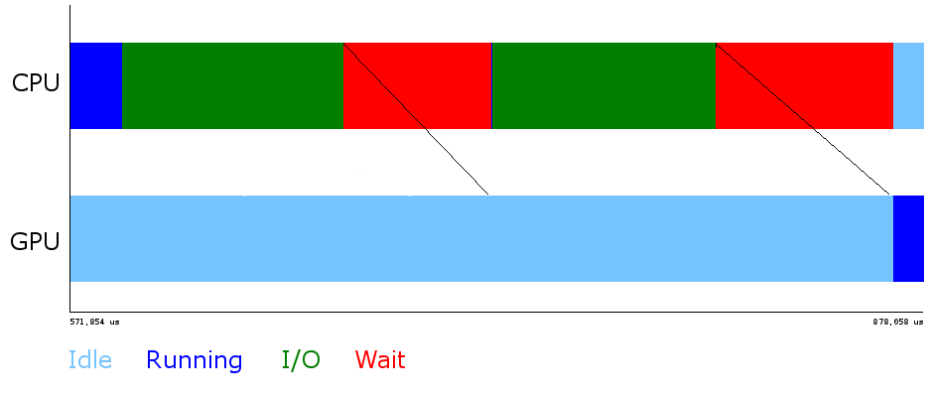
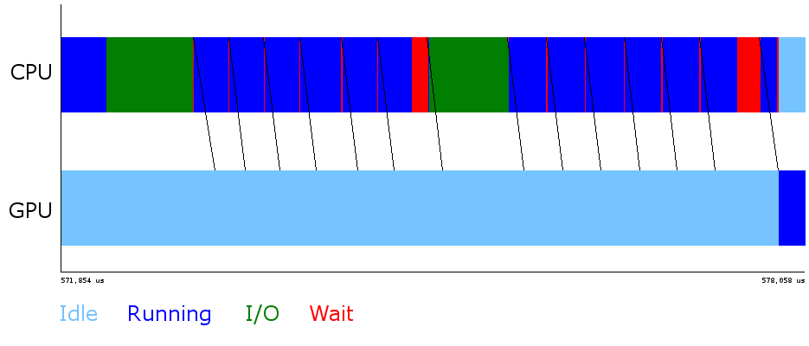
GMAC Optimizations
Global Memory for Accelerators : user-level ADSM run-time
Optimized library calls: memset, memcpy, fread, fwrite, MPI_send, MPI_receive
Double buffering of data transfers
Transfer to GPU while reading from disk

Slide 24
GMAC in Code (I)
int main(int argc, char *argv[])
{
FILE *fp;
struct stat file_stat;
gmacError_t gmac_ret;
void *buffer;
timestamp_t start_time, end_time;
float bw;
if(argc < LAST_PARAM) FATAL("Bad argument count");
if((fp = fopen(argv[FILE_NAME], "r")) < 0)
FATAL("Unable to open %s", argv[FILE_NAME]);
if(fstat(fileno(fp), &file_stat) < 0)
FATAL("Unable to read meta data for %s", argv[FILE_NAME]);

Slide 25
GMAC in Code (I)
gmac_ret = gmacMalloc(&buffer, file_stat.st_size);
if(gmac_ret != gmacSuccess) FATAL("Unable to allocate memory");
start_time = get_timestamp();
if(fread(buffer, 1, file_stat.st_size, fp) < file_stat.st_size)
FATAL("Unable to read data from %s", argv[FILE_NAME]);
gmac_ret = gmacThreadSynchronize();
if(gmac_ret != gmacSuccess) FATAL("Unable to wait for device");
end_time = get_timestamp();
bw = 1.0f * file_stat.st_size / (end_time - start_time);
fprintf(stdout, "%d bytes in %f msec : %f MBps\n", file_stat.st_size,
1e-3f * (end_time - start_time), bw);
gmac_ret = gmacFree(buffer);
if(gmac_ret != gmacSuccess) FATAL("Unable to free device memory");
fclose(fp);
return 0;
}

Slide 26
Performance of GMAC

Slide 27
Any More Questions?

